Slide 1
Digital Portfolio
Student Name: Yuvaraj Kumaran K
Register No And NMID: 2428C0529,
AC418A29D27A46BA9404DF4A9F7BD2B7
Department: Bsc AI & ML
College: KPR College of Arts Science and Research, Bharathiar University

Slide 2
PROJECT TITLE
Culinary Chef Portflio

Slide 3


AGENDA
Problem Statement
Project Overview
End Users
Tools and Technologies
Portfolio design and Layout
Features and Functionality
Results and Screenshots
Conclusion
Github Link
3/21/2024 Annual Review

Slide 4

PROBLEM STATEMENT
Traditional resumes fail to capture the visual creativity of a chef.
Lack of a structured platform to highlight signature dishes, philosophy, and achievements.
Employers and clients struggle to see chef’s talent beyond written words.

Slide 5

PROJECT OVERVIEW
Developed a Culinary Chef Portfolio to showcase professional journey.
Includes: About Me, Education, Experience, Specialties, Gallery, and Contact.
Designed as an interactive and visually appealing presentation.
Objective: To present culinary expertise in a professional and creative way.

Slide 6

WHO ARE THE END USERS?
Restaurant Owners & Recruiters – for hiring chefs.
Clients & Event Planners – for private dining & catering.
Food Enthusiasts – to explore chef’s specialties.
Culinary Institutes – for collaborations, workshops, and recognition.

Slide 7

TOOLS AND TECHNIQUES
- HTML5
- CSS3 (3D Effects, Gradients)
- JavaScript (Interactivity)
- GitHub Pages (Deployment)
- VS Code (Development)

Slide 8
POTFOLIO DESIGN AND LAYOUT
Clean, minimal, and food-inspired design theme 🍴
Slide flow: Introduction → Experience → Specialties → Gallery → Contact
High-quality food photography integrated into layout
Use of icons, infographics, and visuals for better storytelling
8

Slide 9
FEATURES AND FUNCTIONALITY
📖 About Me – Quick professional summary
🎓 Education & Training – Culinary background
💼 Professional Experience – Work history & key responsibilities
🍴 Specialties & Signature Dishes – Unique creations with visuals
📸 Portfolio Gallery – Food styling & presentation images
📞 Contact Section – Easy reach-out details

Slide 10
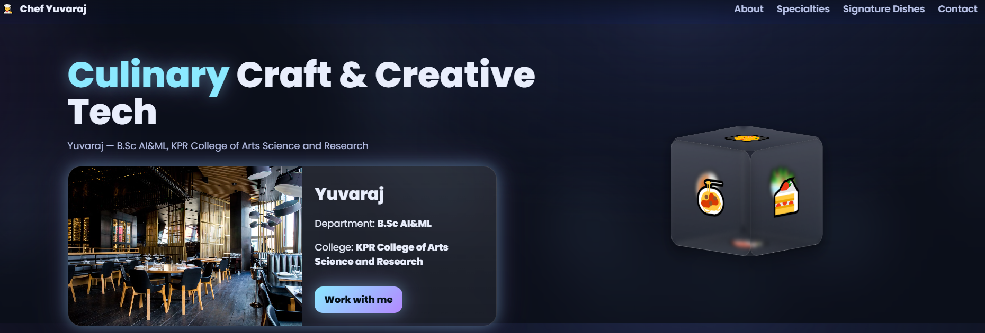

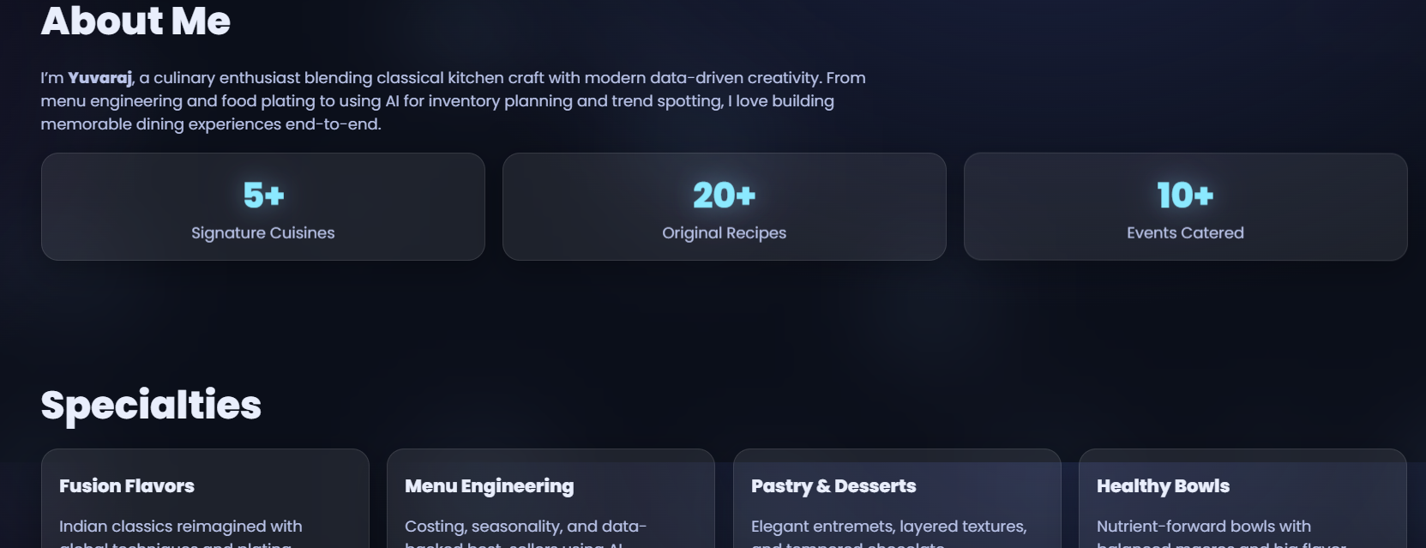
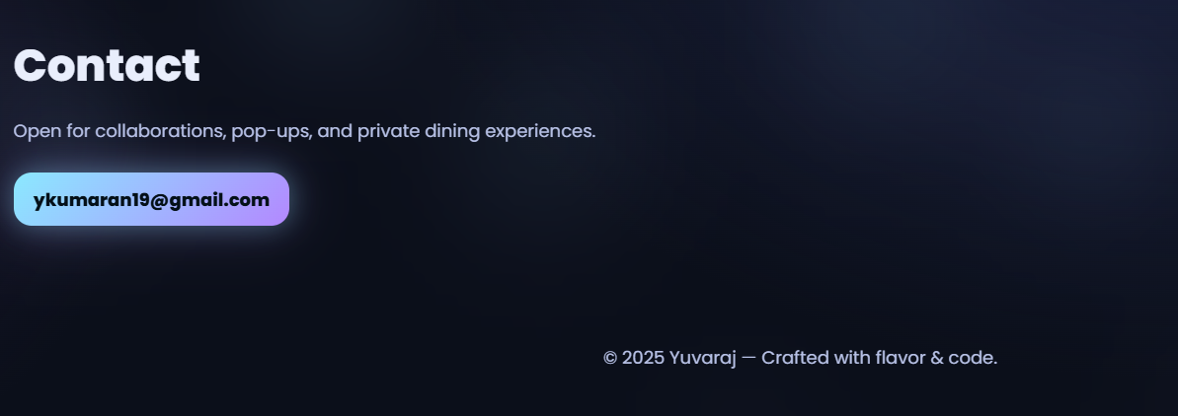
RESULTS AND SCREENSHOTS
Successfully created a professional and visually rich portfolio.
Improved personal branding and professional outreach.
Screenshots:
About Me Page
Signature Dishes Showcase
Portfolio Gallery Layout
3/21/2024 Annual Review
10

Slide 11
CONCLUSION
The Culinary Chef Portfolio serves as a powerful branding tool.
Helps in career growth, networking, and client engagement.
Provides a visual and interactive representation of skills & creativity.
Next step: Expand into an online portfolio website for wider reach.
11

Slide 12
Git hub Link: Portfolio Repository: https://github.com/yuvarajk22/Portfolio.git

